Slide 1
World Population Data Analysis
- By Thanmai Chandaka

Slide 2
Dataset
The dataset is related to World Population from the year 1970 to 2022.
The dataset consists of ,
Population count of each country from the year 1970 to 2022,
Area of each country,
Growth rate,
Ranking,
Capital of each country,
Continents,
World population percentage of each country.

Slide 3
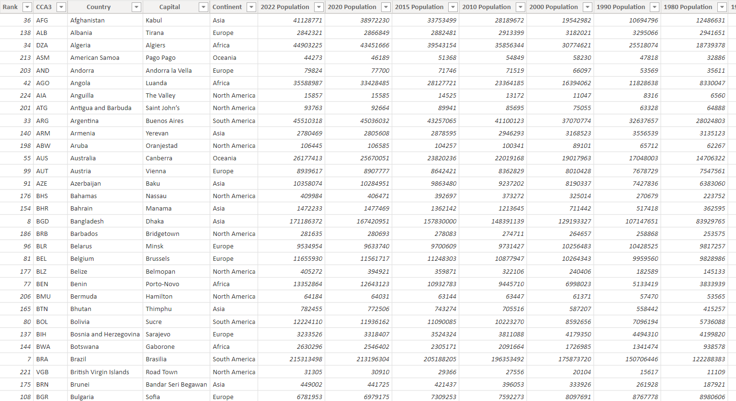
Preview of the dataset

Slide 4
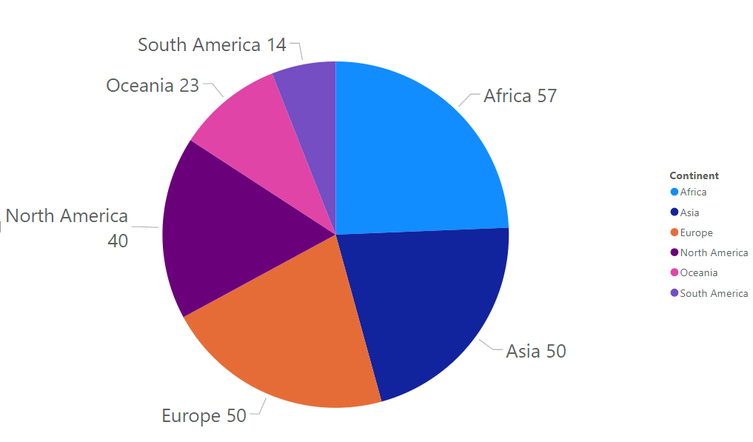
Number of countries in each continent
57 countries are there in Africa, Which is highest among all other continents.
50 countries are there in Europe.
50 countries in Asia.
40 countries in North America.
23 countries in Oceania.
14 countries are there in South America

Slide 5
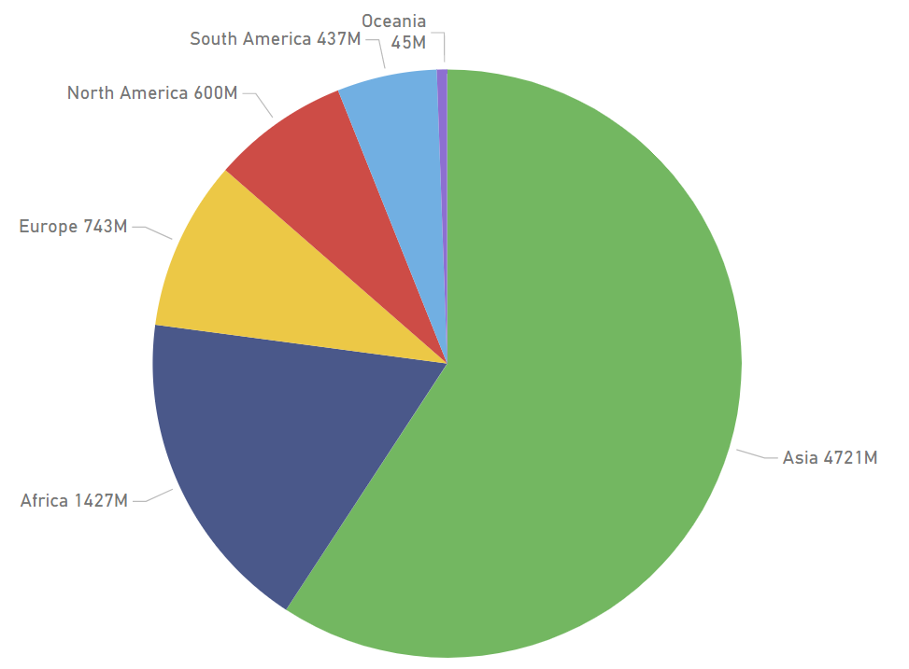
Current population of each continent
Asia continent is having highest population among all the other continents in the world with 4721M.
Africa continent is having population of 1427M.
Europe continent is having a population of 743M.
North America continent is having population of 600M.
South America continent is having population of 437M.
Oceania continent is having population of 45M, which is least among all other continent.

Slide 6
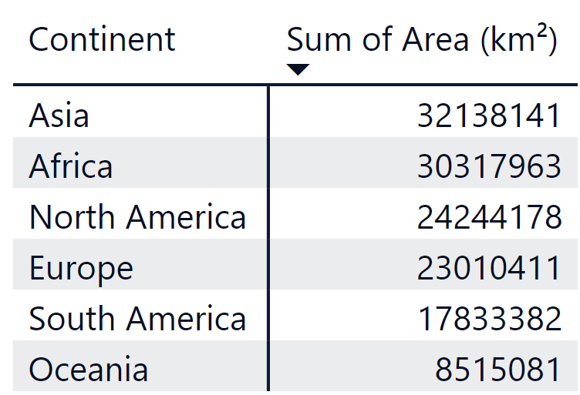
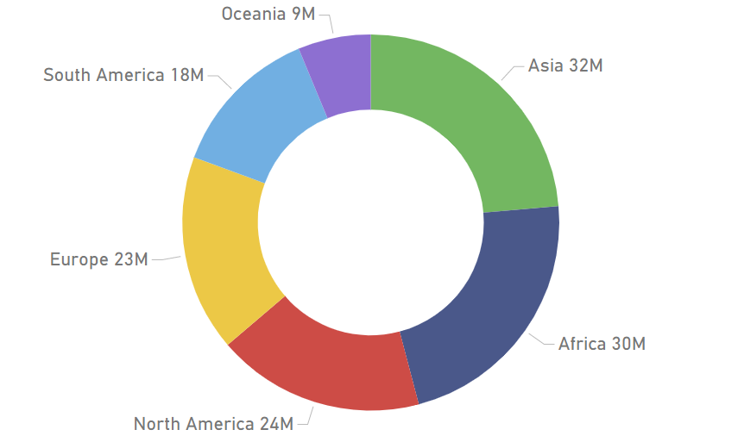
Total area of each continent

Slide 7
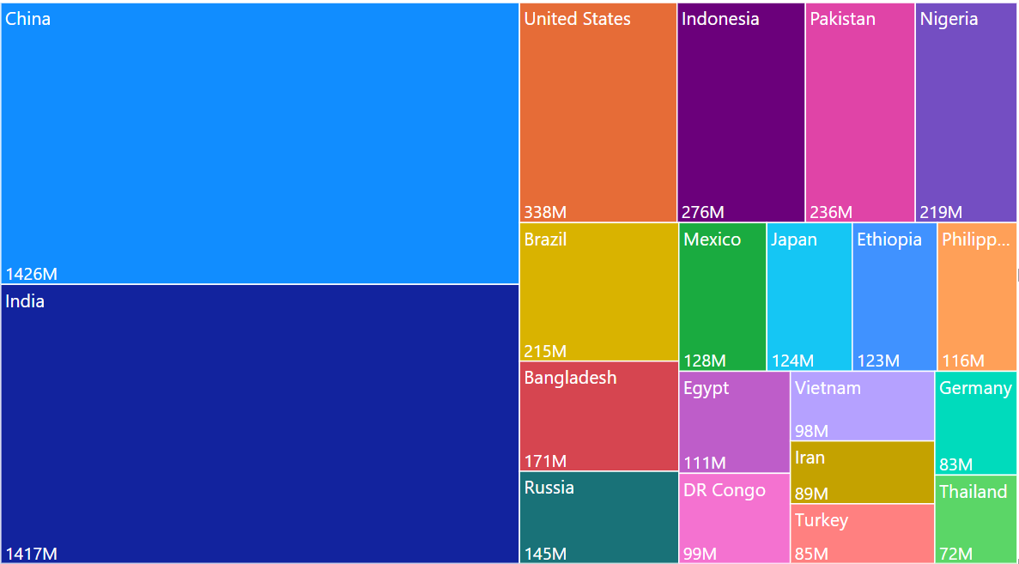
Top 20 highest populated countries in 2022

Slide 8
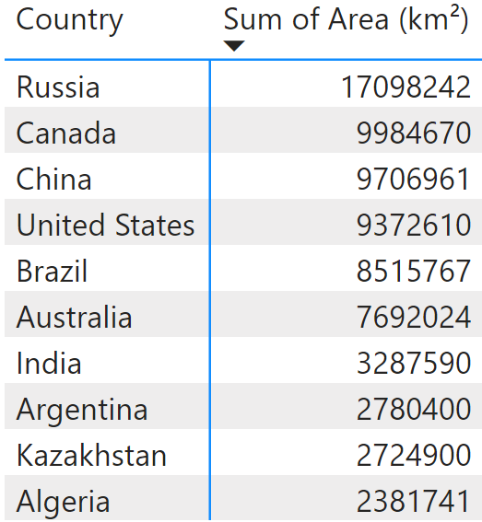
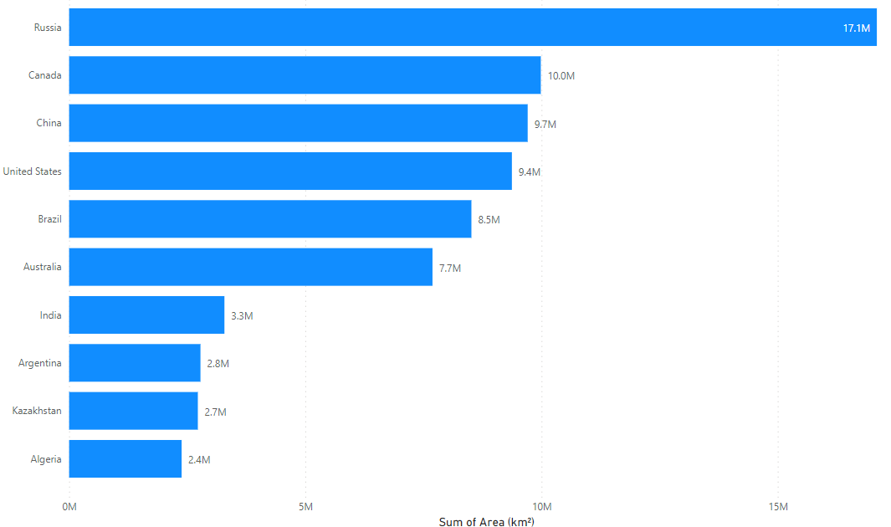
Top 10 countries with largest area

Slide 9
Thank You

